Slide 1
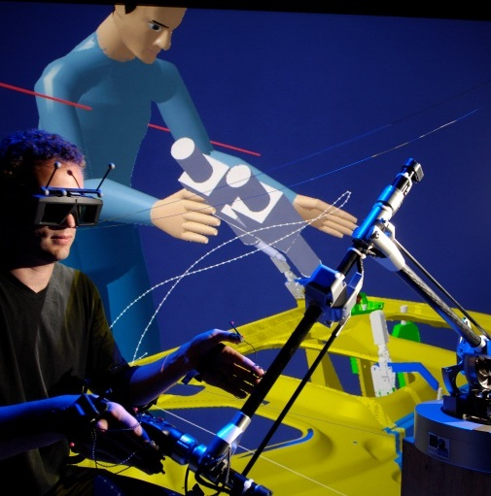
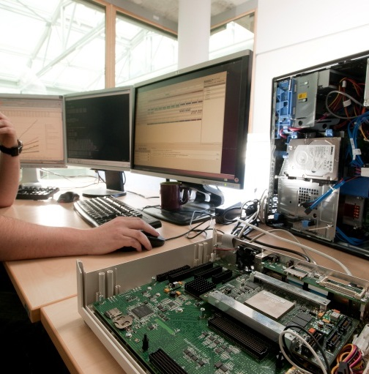
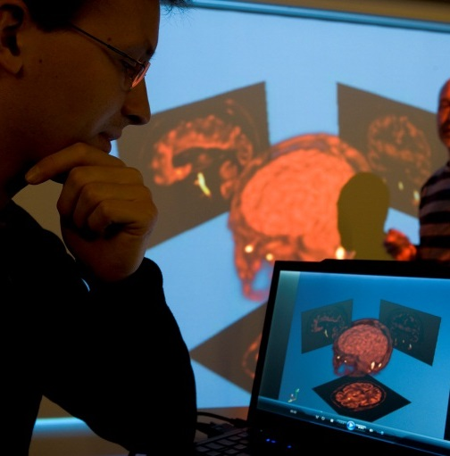
component-based embedded system development: A hybrid approach of modeling and programming

Slide 2
Content
Collaboration scenarios
Papyrus-RTE: Conceptual Framework
Problematic
Motivating Case Study
Papyrus-RTE: Concrete Framework
Experiments
Related work
Conclusion and future work

Slide 3
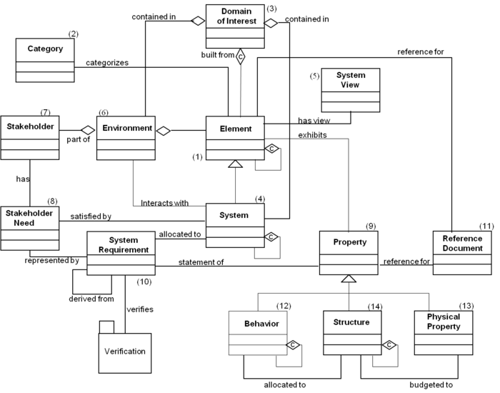
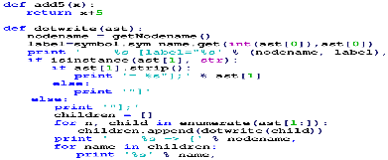
Problematic
Model Driven Engineering (MDE)
Retecence of MDE adoption
Problem understanding
Communication
Code generation
Simulation
Testing
Evolution: Updating models or code?
70 % update models
40 % update code and spend a lot of time to synchronize models and code
Majority of people said that keeping model-code synchronized is critical to the successful use of MDE
[1]
Automation
Abstraction
Complex System
[1] Davide Di Ruscio et al, Model-driven engineering practices in industry: Social,
organizational and managerial factors that lead to success or failure
Notes:
(1 page)
Presents your PhD subject and its context (applicative area, technologies, scientific bootlenecks), what are the scientific motivation and challenges?
Indicates if your research involves collaborating with other labs/teams. If so, present your colleagues and indicates what expertise they bring into your research.
UML and its diagrams (85 %): class, state machine
Domain specific language (39%)
Others: BPMN (24%), SysML (12%)
-Efficient code generation from diagram-based languages for real-time and embedded systems
-Automatic synchronization of models and code

Slide 4


PROBLEMATIC
Architecture Model
Code generation
Code
Architect
modify
modify
Programmer
Architecture Model*
Consistency
Code*
How to preserve changes on different artifacts while keeping them consistent?
Can changes be synchronized in both directions?
Notes:
(1 page)
Presents your PhD subject and its context (applicative area, technologies, scientific bootlenecks), what are the scientific motivation and challenges?
Indicates if your research involves collaborating with other labs/teams. If so, present your colleagues and indicates what expertise they bring into your research.
-Semantic gap of models and generated code runtime execution

Slide 5
WHY IS IT A PROBLEM?
(1) Gap between architecture and implementation: The need for a bidirectional traceability
Gap between architecture and implementation ➔ It is not easy to design software architecture reflecting the intention of developers and implement the result of design modeling as a program while preserving the architectural correctness. [Naoyasu]
In [Taylor]: the need for adequate support for moving from architecture to implementation and fluidly moving between design and coding tasks.
In current MDD tools, to generate full code, we have to:
Adopt domain-specific approaches in which a sufficient set of libraries are prepared for code generation: effective but not easy
Or create models that contain detailed implementation-level behavioral specifications: industrial settings but not favorable because architecture models should be abstract and contain only the essential aspects of architectural design decisions. The detailed considerations about implementation should not be included in the design models.
In the case of the skeleton code generation, a programmer writes the rest of the code and might make a mistake that violates the architectural correctness.
However, the violation in the code is not esy to detect because there is no traceability between architecture and implementation ➔ we need a bidirectional traceability between architecture and implementation. Unfortunately, current MDD tools are insufficient to realize this kind of bidirectional traceability.
[Naoyasu ] Naoyasu Ubayashi, Tetsuo Tamai, Jun Nomura, "Archface: a contract place where architectural design and code meet together", , vol. 01, no. , pp. 75-84,
2010, doi:10.1145/1806799.1806815
[Taylor] Taylor, R. N. and Hoek, A.: Software Design and Architecture –The once and future focus of software engineering, In Proceedings of 2007 Future of
Software Engineering (FOSE 2007), pp.226-243, 2007
Notes:
(1 page)
Presents your PhD subject and its context (applicative area, technologies, scientific bootlenecks), what are the scientific motivation and challenges?
Indicates if your research involves collaborating with other labs/teams. If so, present your colleagues and indicates what expertise they bring into your research.
-Semantic gap of models and generated code runtime execution

Slide 6
WHY IS IT A PROBLEM?
(2) Architecture-code modifications for concurrent development and maintenance
Why code modifications?
Code level optimization, bug fixing, refactoring (renaming, i.e.)
Architecture is not realistic in programming
Programmers do not only modify method bodies, but also structure, methods to adopt well-known programming paradigm
Rarely, the programmers do not change anything in architecture, if changes onccur, they have to be propagated back to the architecture
In software evolution, continuous development and maintenance, the software architects change the architecture for new functionalities or requirements changing while the current architecture is still implemented by programmers ➔ concurrent development. In MDE tools, if regenerate code from the changed architecture, the modifications made by programmers in code are overwritten. Some tools use incremental code generation to preserve the code changes. However, code generated by these tools produce laborious comments which make the code ugly and the programmers feel hard to read and modify (for computational problem)
[Taylor] Taylor, R. N. and Hoek, A.: Software Design and Architecture –The once and future focus of software engineering, In Proceedings of 2007 Future of
Software Engineering (FOSE 2007), pp.226-243, 2007
Notes:
(1 page)
Presents your PhD subject and its context (applicative area, technologies, scientific bootlenecks), what are the scientific motivation and challenges?
Indicates if your research involves collaborating with other labs/teams. If so, present your colleagues and indicates what expertise they bring into your research.
-Semantic gap of models and generated code runtime execution

Slide 7
WHY IS IT A PROBLEM?
(3) Architecture and programmer perception
Working with code is easy for programmers in solving computational/algorithmic problems
Software architects, working at a high level abstract, prefer using graphic-based modeling languages for architecture + logic behavior (via UML State Machine) for concerns
Programmers favor the use of text-based programming languages for fine-grained statements
[Taylor] Taylor, R. N. and Hoek, A.: Software Design and Architecture –The once and future focus of software engineering, In Proceedings of 2007 Future of
Software Engineering (FOSE 2007), pp.226-243, 2007
Notes:
(1 page)
Presents your PhD subject and its context (applicative area, technologies, scientific bootlenecks), what are the scientific motivation and challenges?
Indicates if your research involves collaborating with other labs/teams. If so, present your colleagues and indicates what expertise they bring into your research.
-Semantic gap of models and generated code runtime execution

Slide 8
Challenges
Gap between architecture model and code
No trivial mapping between architecture model and code
Traceability between model and code is hard
Round-trip engineering between architecture and code is considered as a very hard problem
Concurrent modification
Model and code evolve concurrently
Architecture refinement, refactoring…
Code-level bug fixing, optimizations, refinement, refactoring…
Notes:
We handle C++ and not C
We try to transform C to some object-oriented model but we don’t guarantee total reverse of C at the moment

Slide 9
Scope
UML
Class, component, composite structure as architecture model
State machine as behavior model
Code
Object-oriented language: C++, Java
Notes:
We handle C++ and not C
We try to transform C to some object-oriented model but we don’t guarantee total reverse of C at the moment

Slide 10
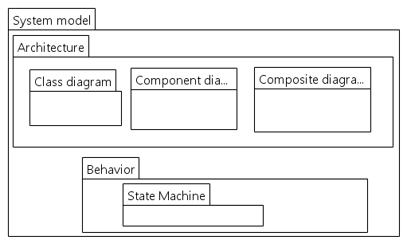
Scope
Modeling world
Programming world
Model transformation
Code generation
Synchronization
Reverse engineering
Notes:
We handle C++ and not C
We try to transform C to some object-oriented model but we don’t guarantee total reverse of C at the moment

Slide 11
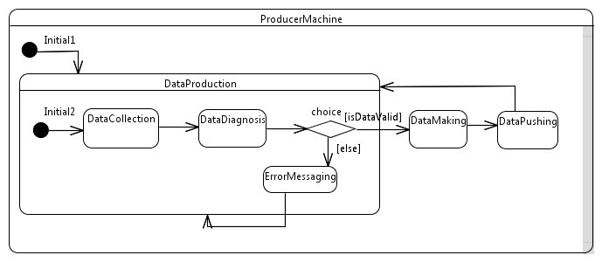
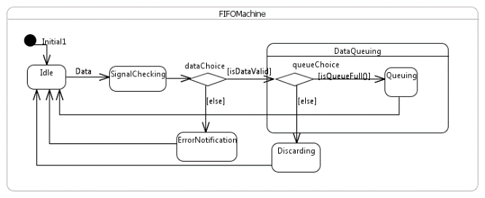
Motivating example
Transformation chain
System
p :Producer
«FIFO»
c :Consumer
Connector transformation
System
Push
Pull
p :Producer
fifo:FIFO
c :Consumer
Component to OO
System
p :Producer
fifo:FIFO
State machine classes
c :Consumer
OOP Code
Notes:
We handle C++ and not C
We try to transform C to some object-oriented model but we don’t guarantee total reverse of C at the moment

Slide 12
Motivating example
Transformation chain
System
p :Producer
«FIFO»
c :Consumer
-Traceability is hard
-Round-trip engineering is hard
Big abstraction gap
OOP Code
Notes:
We handle C++ and not C
We try to transform C to some object-oriented model but we don’t guarantee total reverse of C at the moment

Slide 13
Approach in a nutshell
Architecture model
Intermediate model/language
OOP code
Rather than direct synchronization of architecture model and OOP code, our approach synchronizes architecture model with an intermediate model at a sufficient abstraction level
At which abstraction level? Requirements for the indermediate?
?
Notes:
We handle C++ and not C
We try to transform C to some object-oriented model but we don’t guarantee total reverse of C at the moment

Slide 14
Approach in a nutshell
R1: The intermediate language has the ability to connect to the architecture model through a trivial mapping between the architecture and this language ➔ propose concepts closely mapped to the architecture concepts
R2: A synchronization mechanism must be established between the architecture model and the intermediate language in case of concurrent synchronization ➔ propose a synchronization mechanism
R3: The intermediate language must be textual for programmers’ perception, contain mechanisms and constructs to specify fine-grained statements, computational algorithms that can be done in OOPLs can be done, and must be similar to object-oriented languages so that programmers can easily use it
Separation of architecture + high abstraction level behavior from fine-grained behavior
Architecture model
Intermediate model/language
OOP code
Notes:
We handle C++ and not C
We try to transform C to some object-oriented model but we don’t guarantee total reverse of C at the moment

Slide 15
Approach in a nutshell
Architecture Model
Intermediate language
OO languages
An intermediate language RTE4Comp is proposed for programmers
RTE4Comp is a component and object-oriented hybrid language
RTE4Comp is used for whole system implementation, not just architecture/behavior description or contract
RTE4Comp adds more constructs to OO languages:
UML State Machine constructs: state, transition, event, pseudo state, action
Component constructs: component, part, port, connector
Reuse maximally existing constructs in OO languages such as class, attribute
RTE4Comp is synchronized with models by a trivial mapping
Notes:
We handle C++ and not C
We try to transform C to some object-oriented model but we don’t guarantee total reverse of C at the moment

Slide 16

Illustrative example
System
Push
Pull
p :Producer
fifo:FIFO
c :Consumer
Notes:
We handle C++ and not C
We try to transform C to some object-oriented model but we don’t guarantee total reverse of C at the moment

Slide 17
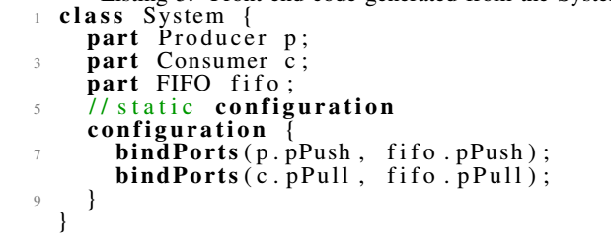
RTE4Comp as a Component-based language
Components and parts
System
Push
Pull
p :Producer
fifo:FIFO
c :Consumer
Notes:
We handle C++ and not C
We try to transform C to some object-oriented model but we don’t guarantee total reverse of C at the moment

Slide 18
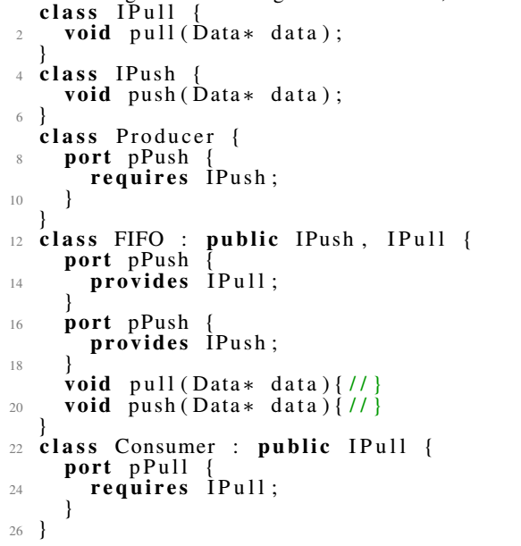
RTE4Comp as a Component-based language
Ports and bindings
Notes:
We handle C++ and not C
We try to transform C to some object-oriented model but we don’t guarantee total reverse of C at the moment

Slide 19
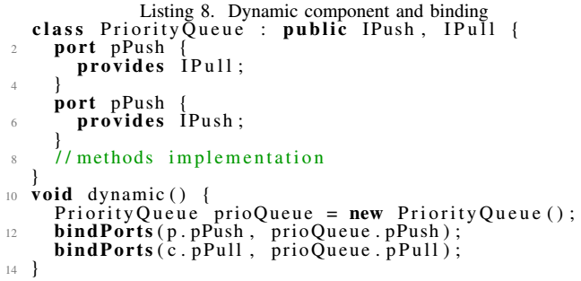
RTE4Comp as a Component-based language
Dynamic components and bindings
System
Push
Pull
p :Producer
fifo:FIFO
c :Consumer
System
Push
Pull
p :Producer
prioQueue: PriorityQueue
c :Consumer
Notes:
We handle C++ and not C
We try to transform C to some object-oriented model but we don’t guarantee total reverse of C at the moment

Slide 20
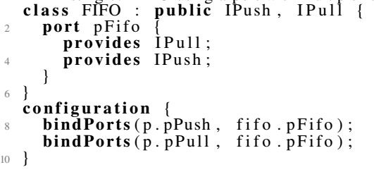
RTE4Comp as a Component-based language
Ports with multiple interfaces
Notes:
We handle C++ and not C
We try to transform C to some object-oriented model but we don’t guarantee total reverse of C at the moment

Slide 21
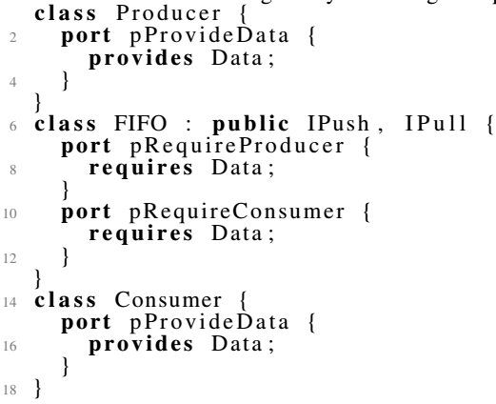
RTE4Comp as a Component-based language
Data port
System
p :Producer
Data
fifo:FIFO
Data
c :Consumer
Notes:
We handle C++ and not C
We try to transform C to some object-oriented model but we don’t guarantee total reverse of C at the moment

Slide 22
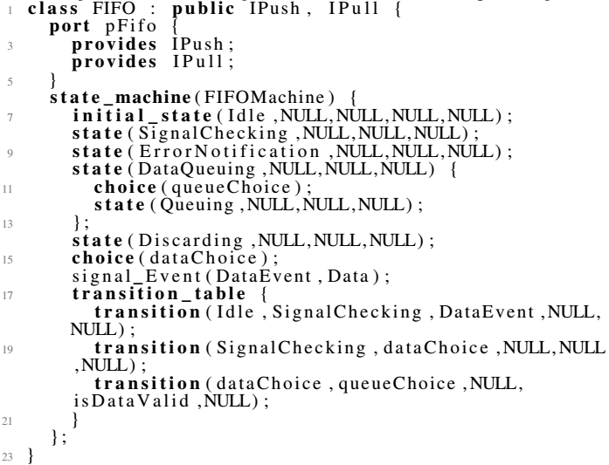
Rte4comp as state machine-based language
Notes:
We handle C++ and not C
We try to transform C to some object-oriented model but we don’t guarantee total reverse of C at the moment

Slide 23
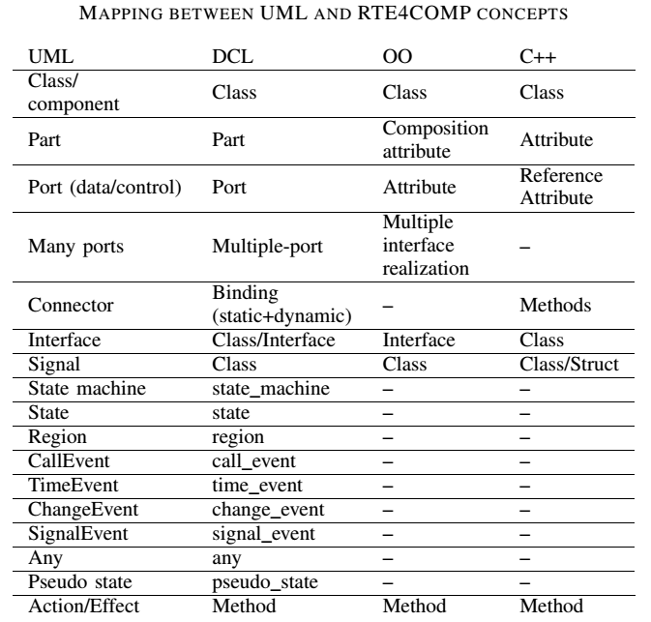
Process for synchronization
Mapping
Notes:
We handle C++ and not C
We try to transform C to some object-oriented model but we don’t guarantee total reverse of C at the moment

Slide 24
How are the problems are solved?
Problem 1: UML concepts in diagrams are mapped to the constructs in the proposed C++-based language
Problem 2: The synchronization is realized by using the mechanisms which are adapted to architects and programmers using the mapping between architecture + the language
Problem 3: the language has all of abilities of OOP (C++) => perception, text…

Slide 25
Conclusion and Future Work

